Slide 1
Using Gather.Town
An Introduction to the JLOEB House
Membership Training
November 5, 2020

Slide 2

What is Gather.Town?

Slide 3
Basics of Gather
Use a PC or laptop with a keyboard
Use Google Chrome or Firefox
Make sure you have audio and video
Go to https://gather.town
Create an account to save your settings, or join rooms anonymously

Slide 4
Starting Up

Slide 5
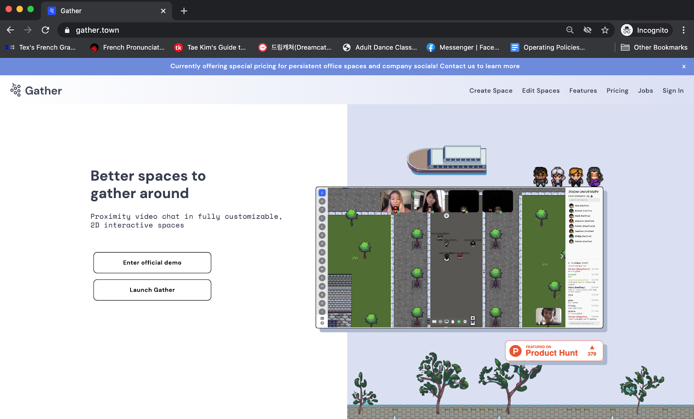
Starting Up

Slide 6
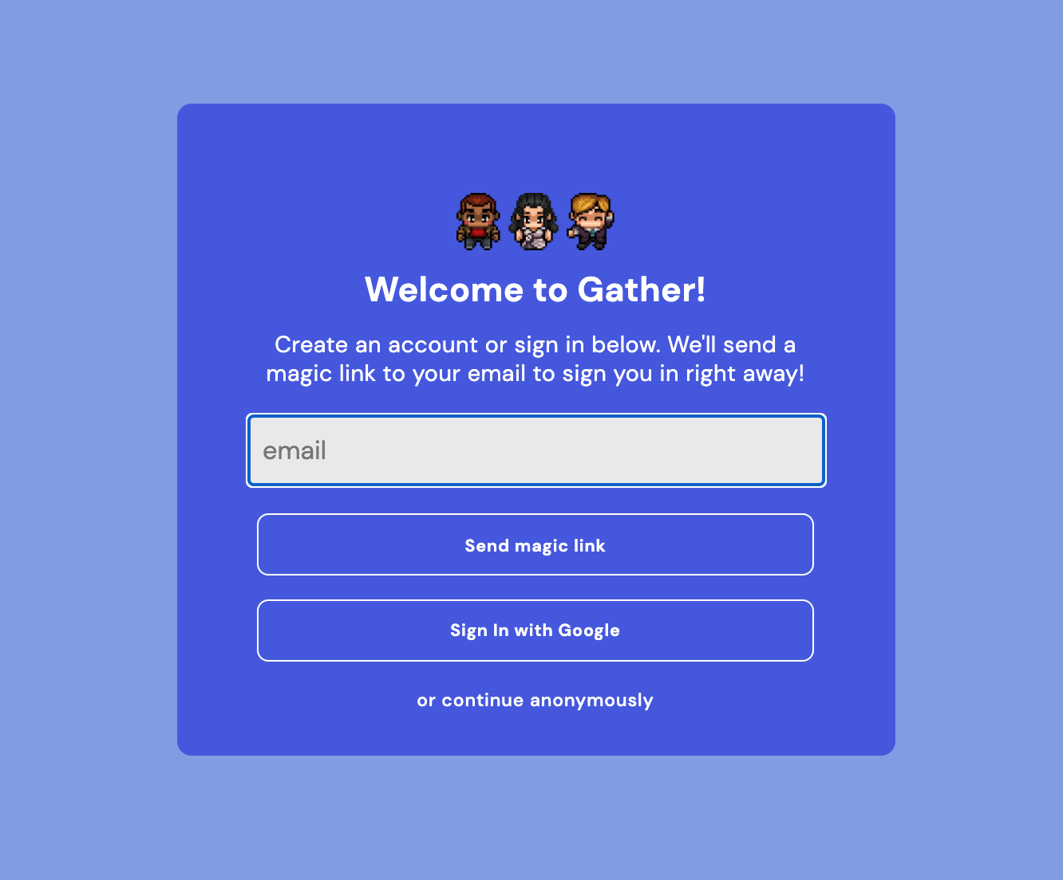
Starting Up

Slide 7
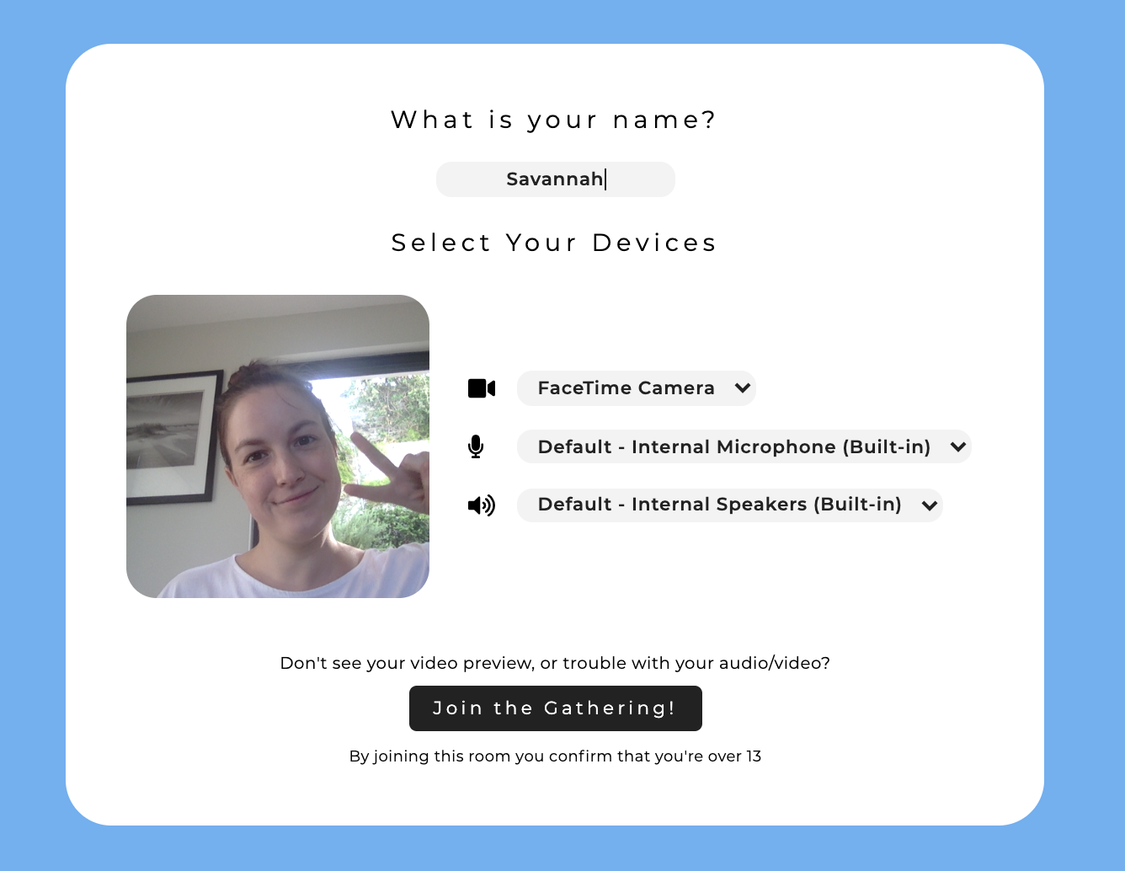
Starting Up

Slide 8
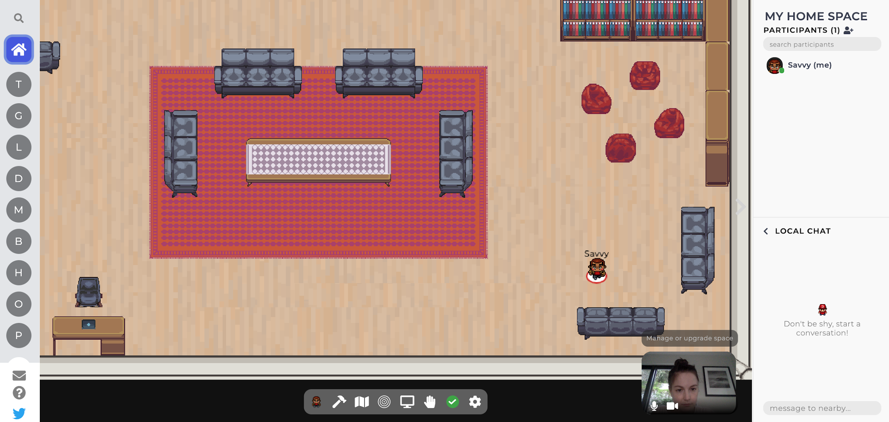
The Interface

Slide 9
Basic Skills

Slide 10
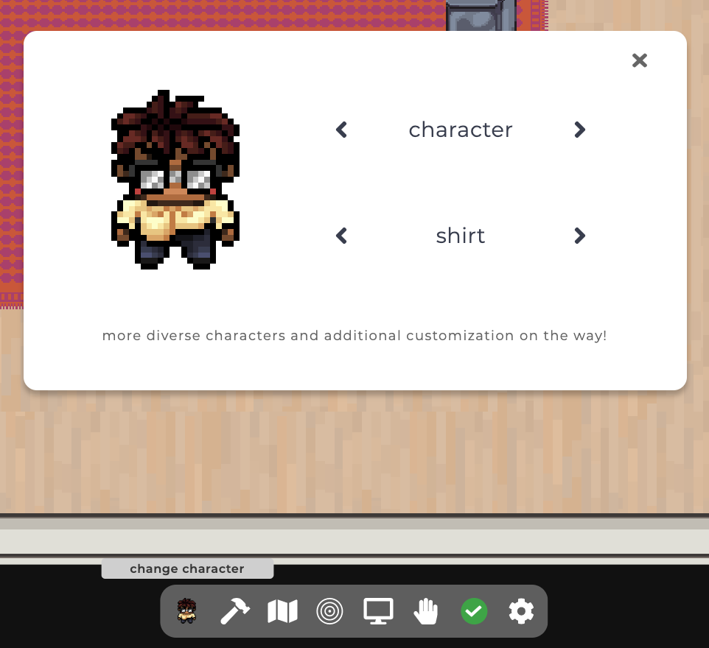
Setting Your Avatar

Slide 11
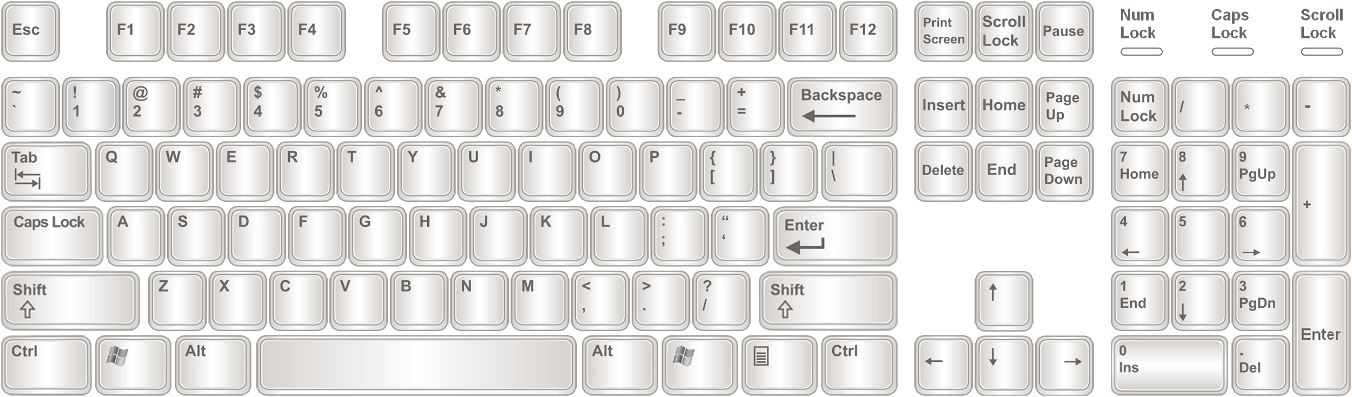
Moving Around

Slide 12
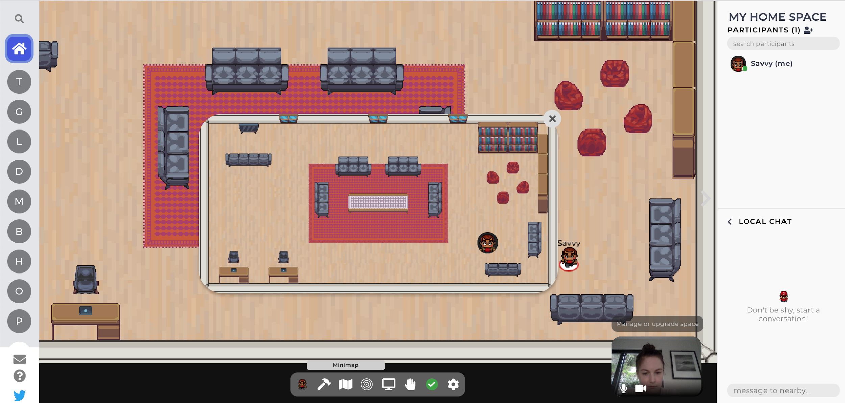
Find Where You Are

Slide 13
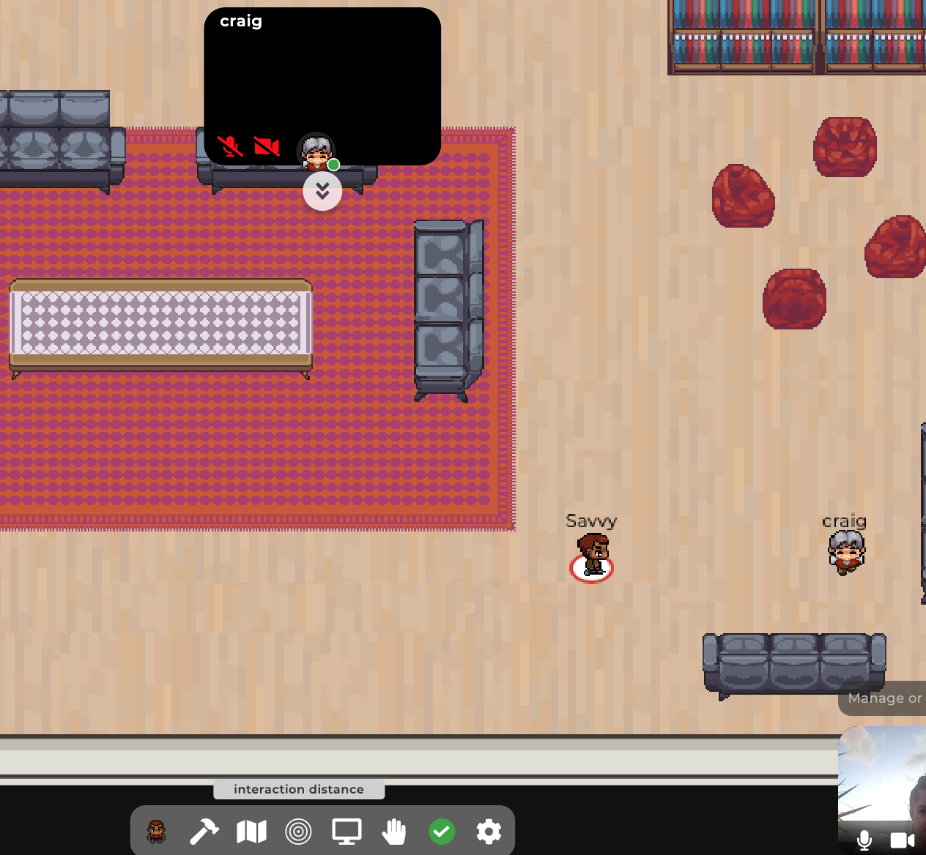
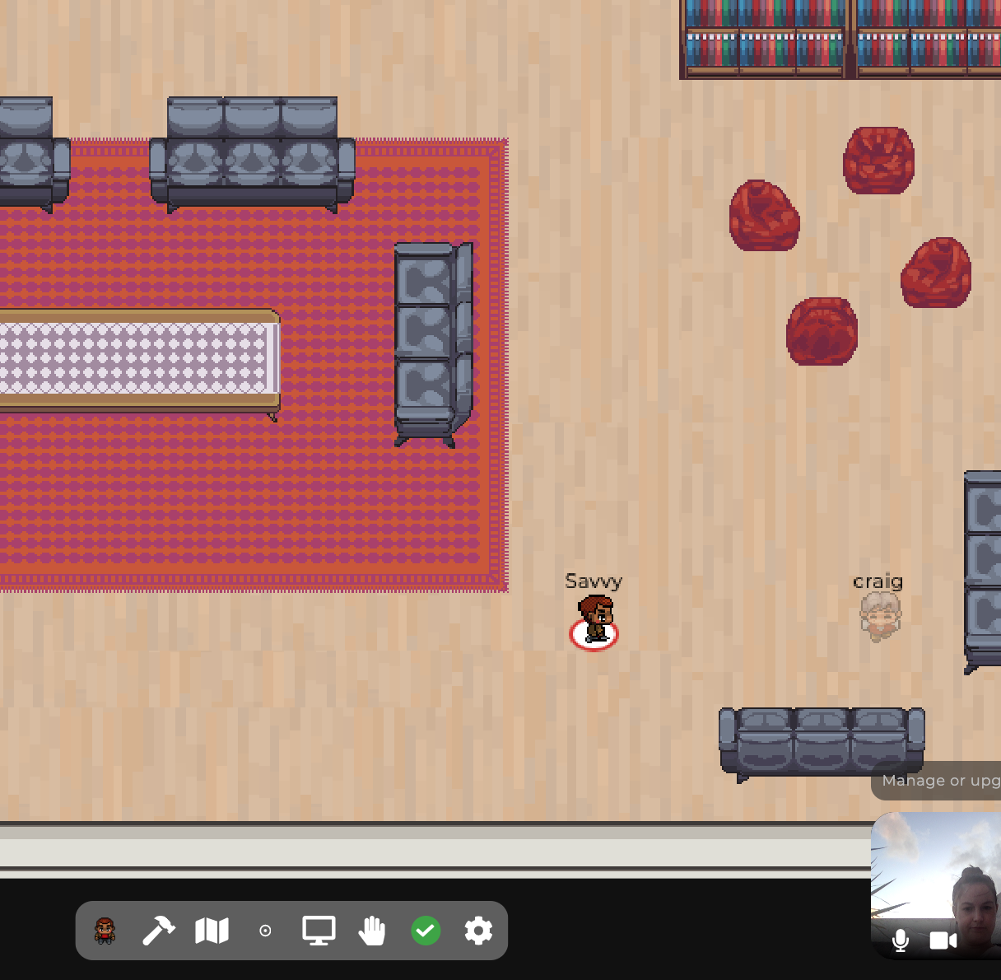
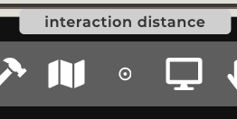
Avatar Interaction
Walk up to people to see and hear them
Set your interaction distance to how far away you want to be able to interact

Slide 14
Environment Interaction

Slide 15
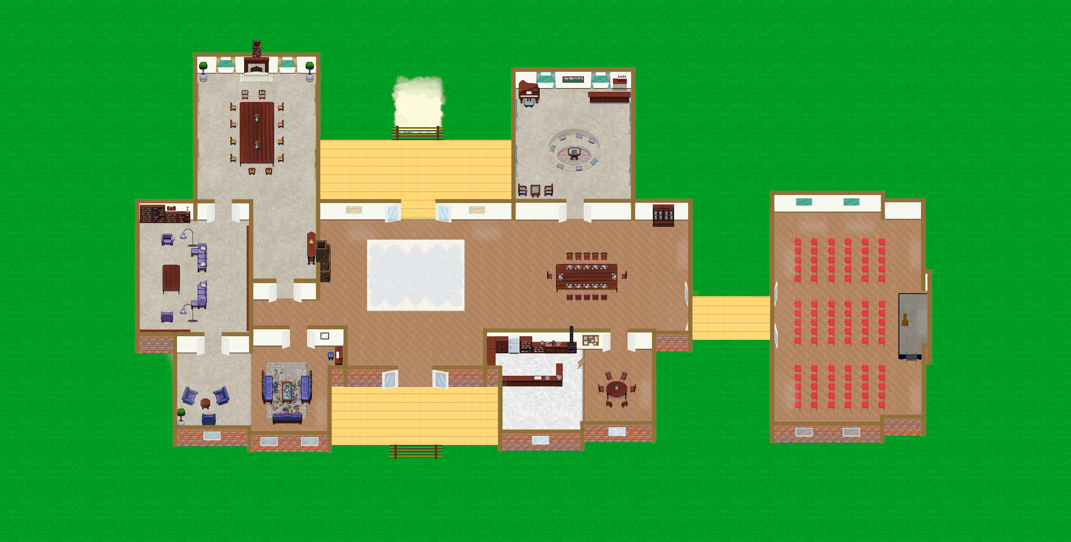

Slide 16
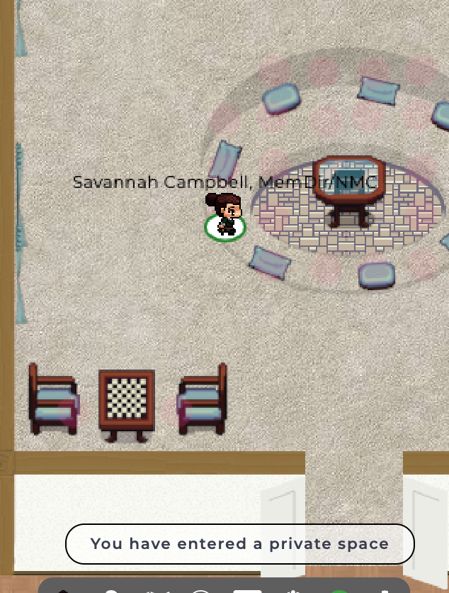
Private Spaces

Slide 17
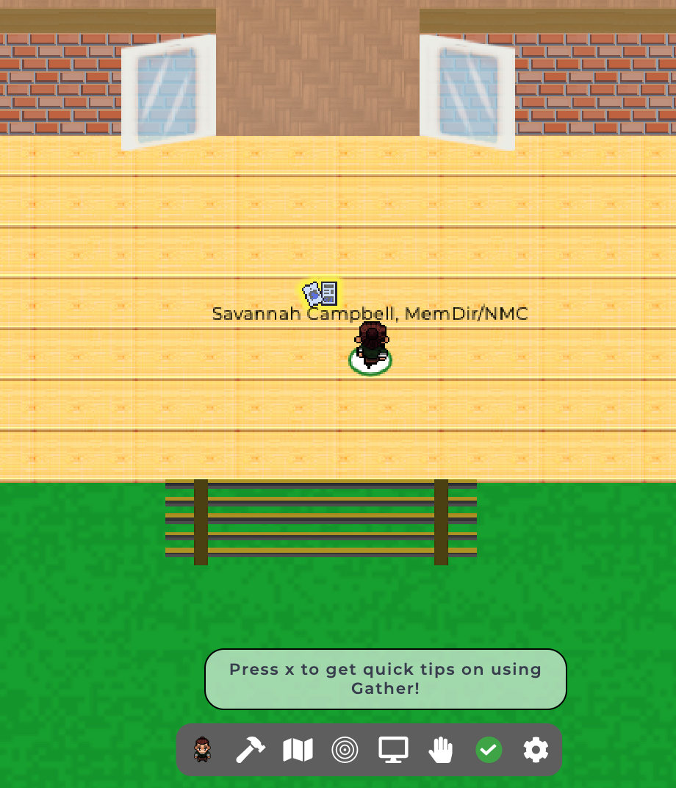
Interactable Objects

Slide 18
The JLOEB Bulletin Board

Slide 19
Tips and Tricks

Slide 20
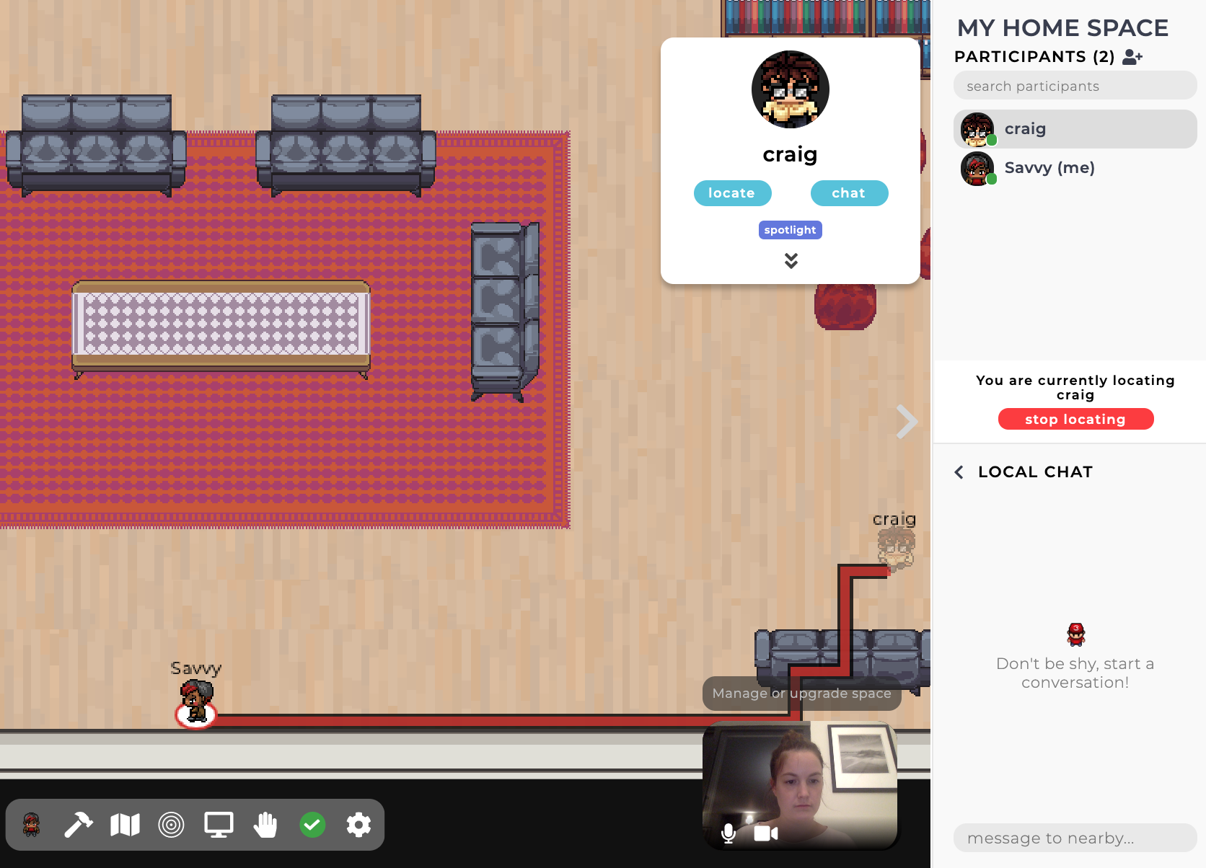
Finding People
Find friends by clicking on them and pressing "locate"

Slide 21
Chat Box
Type in the Local or Global Chat boxes to speak to everyone in the room
Click on a friend and select "chat" to message them directly

Slide 22
Chat Focus
Click on the arrow below your friends' video feeds to bring up a gallery view of the videos

Slide 23
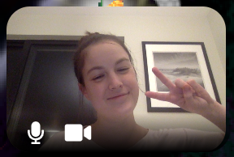
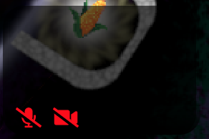
Going AFK

Slide 24
Getting Lost and Stuck
Press the "g" key while walking to go through people

Slide 25
Getting Lost and Stuck
Click "Respawn" in the settings to return where you first started

Slide 26
Dance!
Press "z" to show your excitement!

Slide 27
Followup Info

Slide 28
Leaving the Room
Just close the window!

Slide 29
Let's go to the JLOEB House!
https://gather.town/app/E6EYRyJFw0lHhxPC/TheJLOEBHouse
PW: txfmingV1rtualC0mmunitie5

